Slide 1
Distance Measures

Slide 2
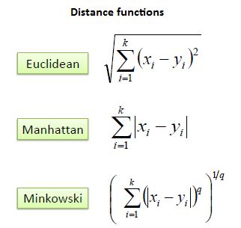

Slide 3
Optimization algorithms for KNearestNeighbor
KD Tree
Ball tree
Brute force

